Slide 1
http://www.vidyanidhi.com/
ketkiacharya.net@gmail.com
REACT JS
Ketki Acharya
From: SM VITA ATC of CDAC
9769201036
ketkiacharya.net@gmail.com

Slide 2
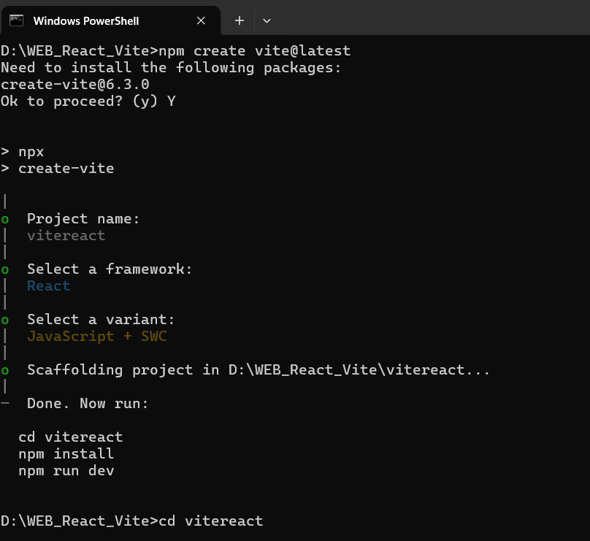
npm create vite@latest
npm install
npm run dev
SWC stands for Speedy Web Compiler.
It is a JavaScript and TypeScript compiler written in Rust, designed to be faster than traditional JavaScript build tools like Babel.
SWC is used for transpilation, taking modern JavaScript/TypeScript code and converting it into code that can be run in older browsers.
It can also be used for bundling and minification.
Due to its speed and efficiency, SWC is often integrated into other tools and frameworks like Next.js, Parcel, and Deno to improve build times

